Slide 1
VOLUNTEER
RECOGNITION
PROGRAM
City of Pico Rivera
Parks and Recreation Department

Slide 2

Purpose
The Volunteer Recognition Program is designed to acknowledge and celebrate the invaluable contributions of our volunteers. This program aims to enhance volunteer morale, encourage continued participation, and recognize the diverse ways in which our volunteers impact our community.

Slide 3
Categories of recognition
Mayor’s Volunteer of the Year: For exceptional dedication and impact, demonstrating significant contributions over the past year.
Rising Star: For new volunteers who have shown remarkable promise and commitment in a short time.
Youth Ambassador: For youth volunteers between the ages of 11-18 whose efforts have greatly impacted the community in the past year.
Community Champion: For volunteers whose efforts have significantly benefited the community throughout the years. This category will have the following subdivisions:
  Community Sports (Community Sports Organizations, Pico Rivera Youth Sports)
  Community Events (Special Events, Summer Food Service Program)
  Serving Seniors (Senior Center Events, Senior Center Services)

Slide 4
ELIGBILITY
Residency Requirements: Volunteers must be a resident of the city of actively involved in city-sponsored programs or activities.
Type of Volunteer Work: Eligible volunteer work must be conducted through city-sponsored programs, city-recognized non-profit organizations, or city-recognized community service initiatives.
Age Requirements: Volunteers must be at least 11 years of age to be recognized. If under 18, they must have parental consent for nomination.
Recognition Period: Recognition is awarded on an annual basis.
Criteria: Nominee has not been honored with the award in previous years.

Slide 5
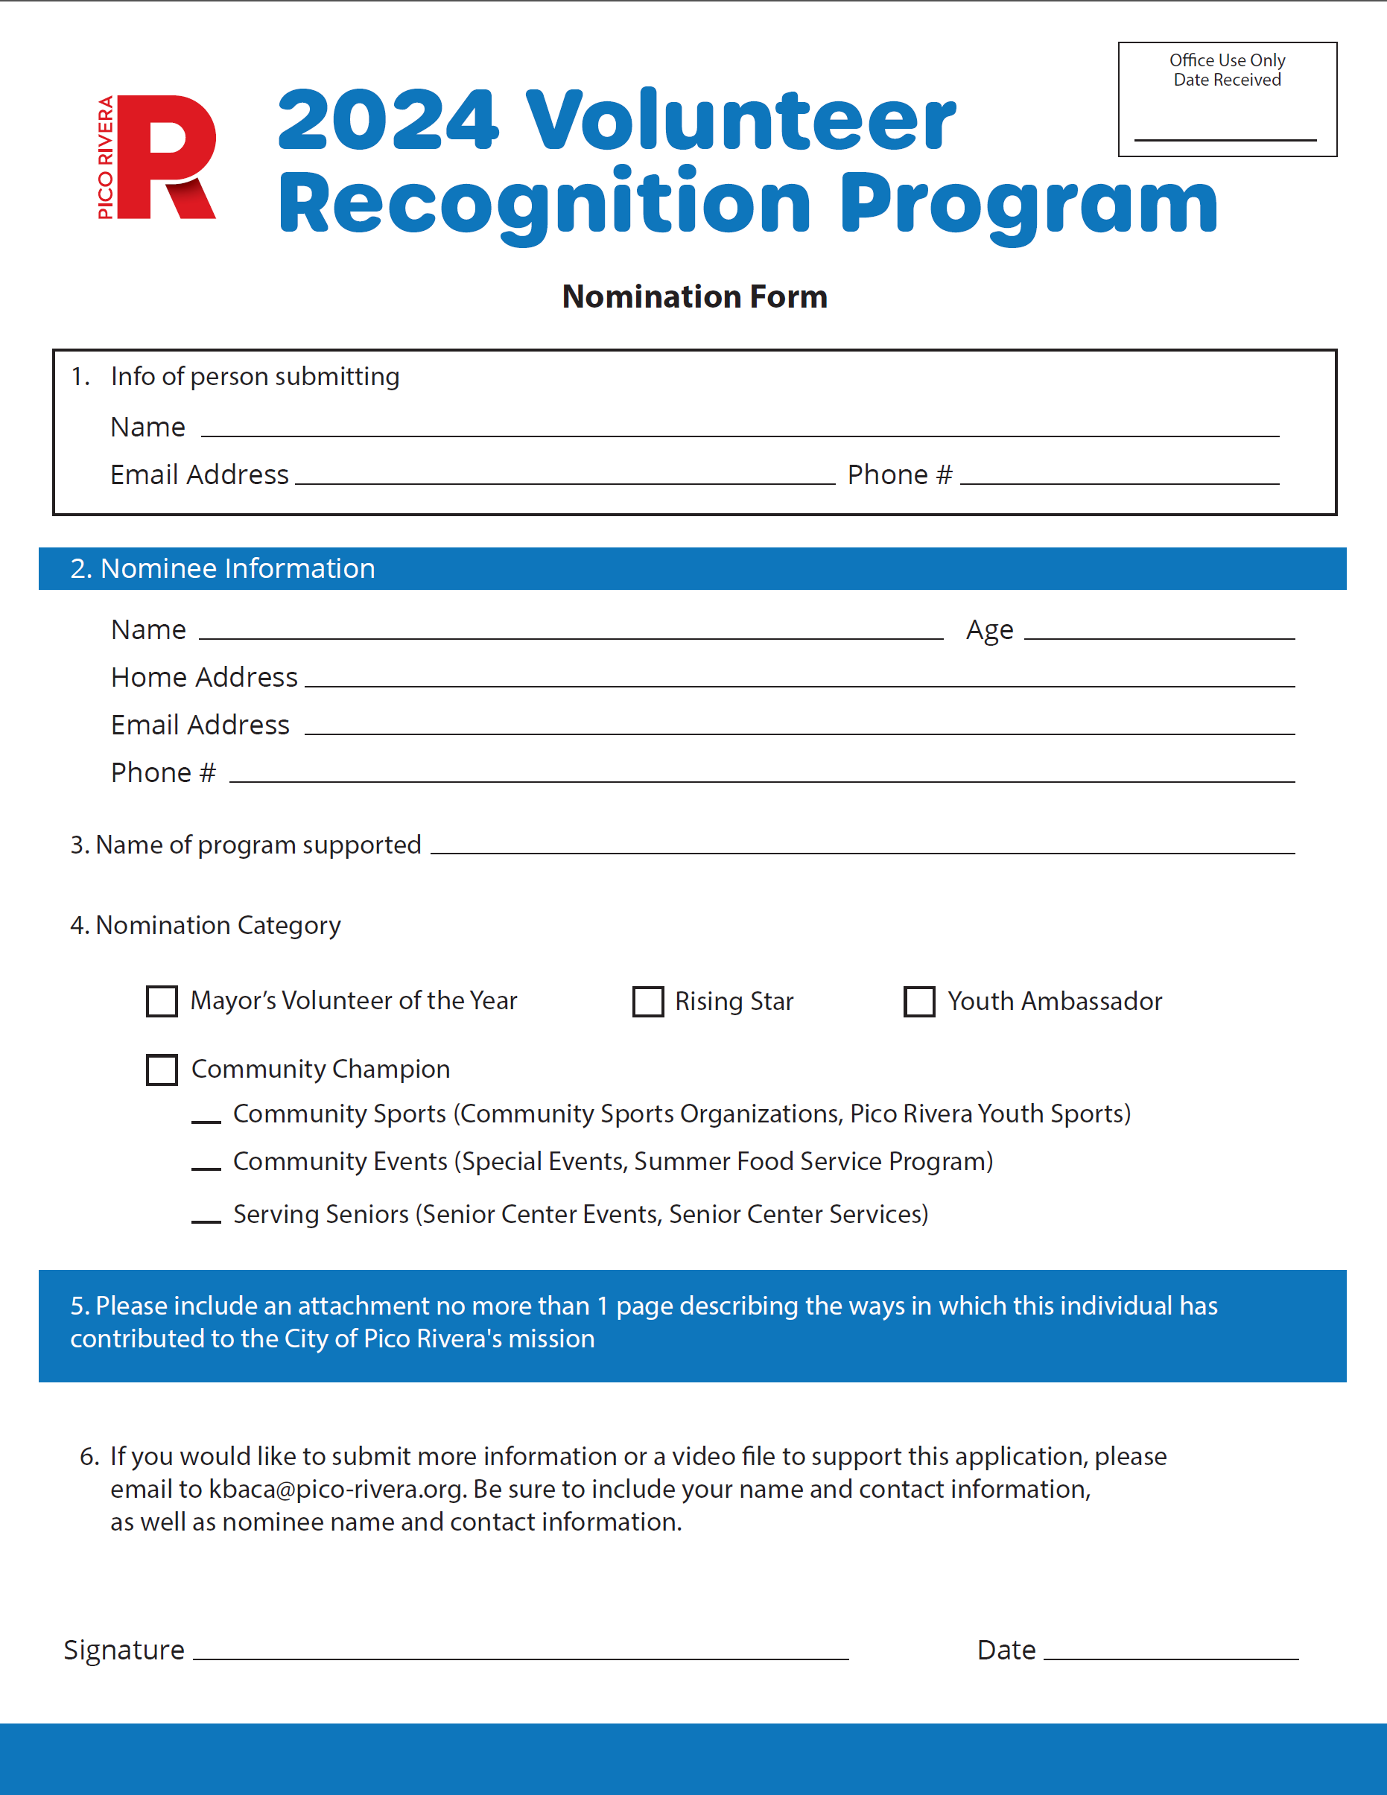
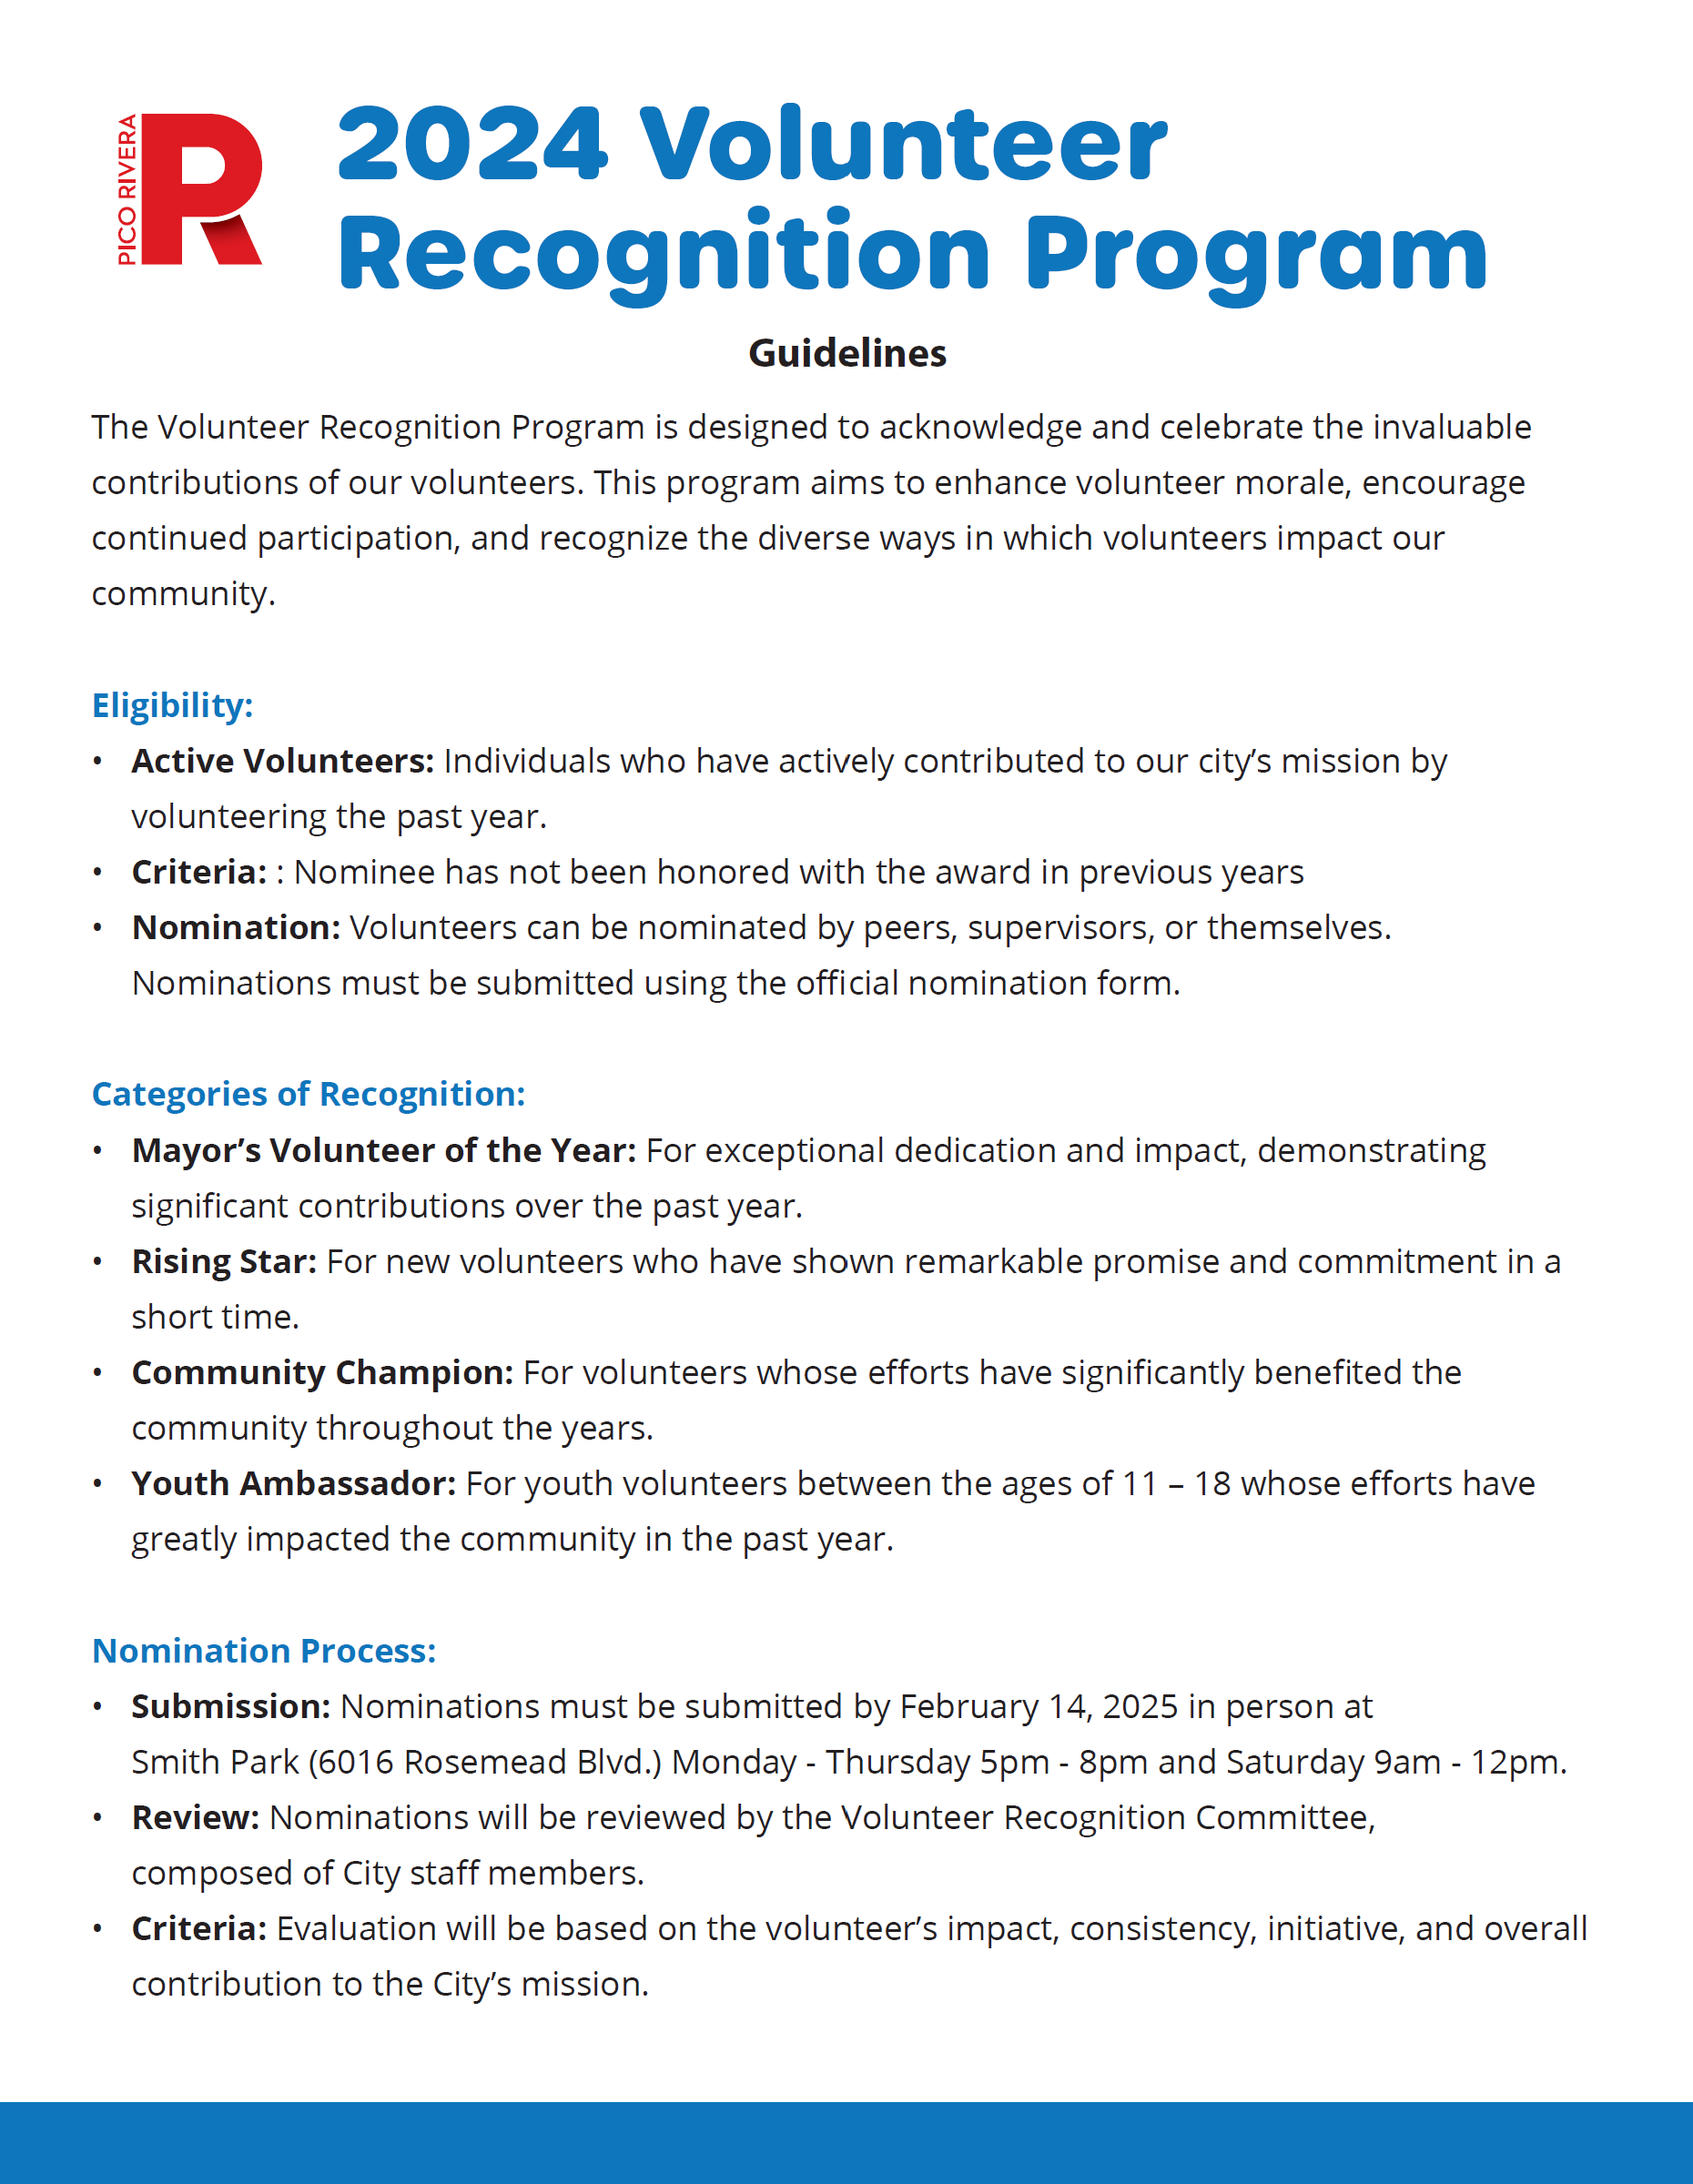
Nomination process
Submission: Nomination forms must be submitted by February 26, 2025 through March 13, 2025 in person at Smith Park (6016 Rosemead Blvd.)
Review: Nominations will be reviewed by the Volunteer Recognition Committee
Criteria: Evaluation will be based on the volunteer’s impact, consistency, initiative, and overall contribution to the City’s mission.

Slide 6
RECOGNITION AND AWARDS
City Council Meeting: Award recipients will be presented with a proclamation
Ceremony: An annual recognition event will be held, where awards will be presented. More details to come
Awards: Each category will have a designated award, which may include plaques, certificates, or other tokens of appreciation
Public Acknowledgment: Award recipients will be featured in the City’s newsletter, website, and social media channels

